Slide 1
Hashing
CS 311 Data Structures

Slide 2
Introduction
Suppose we want to design a system for storing employee records keyed using phone numbers. And we want following queries to be performed efficiently:
Insert a phone number and corresponding information.
Search a phone number and fetch the information.
Delete a phone number and related information.

Slide 3
Introduction
We can think of using the following data structures to maintain information about different phone numbers.
Array of phone numbers and records.
Linked List of phone numbers and records.
Balanced binary search tree with phone numbers as keys.
Direct Access Table (a big array).

Slide 4
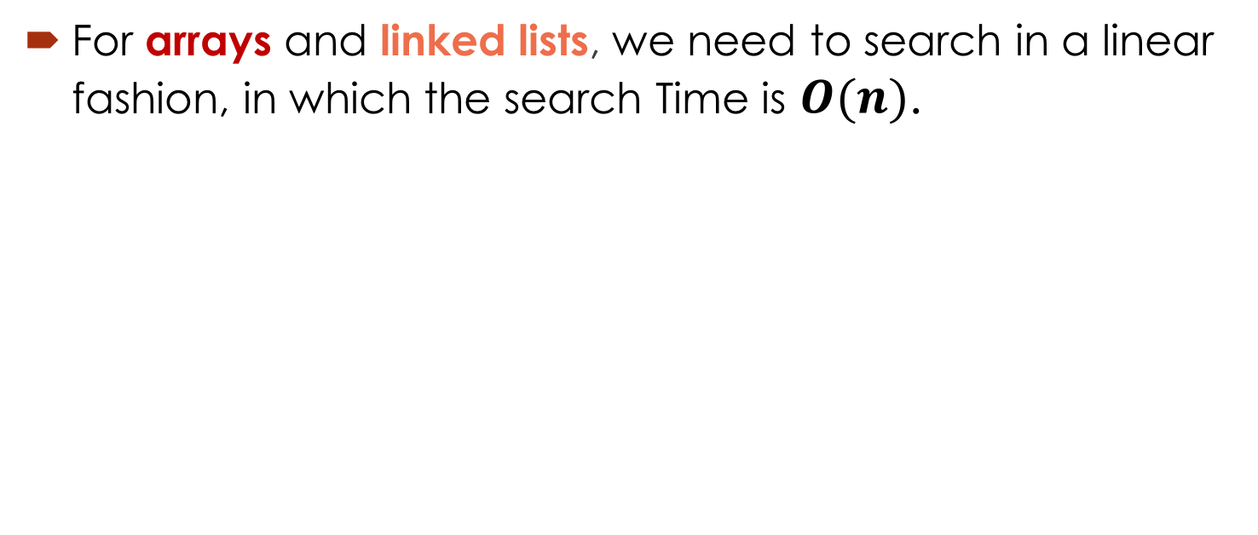
Introduction
For arrays and linked lists, we need to search in a linear fashion, in which the search Time is $O(n)$.

Slide 5
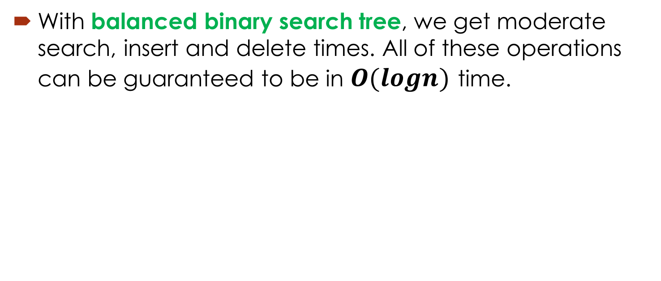
Introduction
With balanced binary search tree, we get moderate search, insert and delete times. All of these operations can be guaranteed to be in $O(logn)$ time.

Slide 6
Introduction
Another solution that one can think of is to use a direct access table where we make a big array and use phone numbers as index in the array.
An entry in array is NIL if phone number is not present, else the array entry stores pointer to records corresponding to phone number.

Slide 7
Introduction

Slide 8
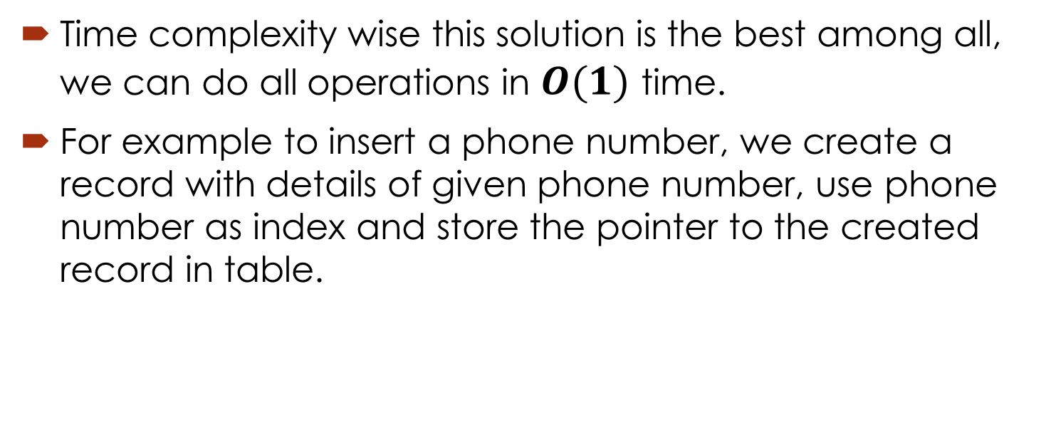
Introduction
Time complexity wise this solution is the best among all, we can do all operations in $O(1)$ time.
For example to insert a phone number, we create a record with details of given phone number, use phone number as index and store the pointer to the created record in table.

Slide 9
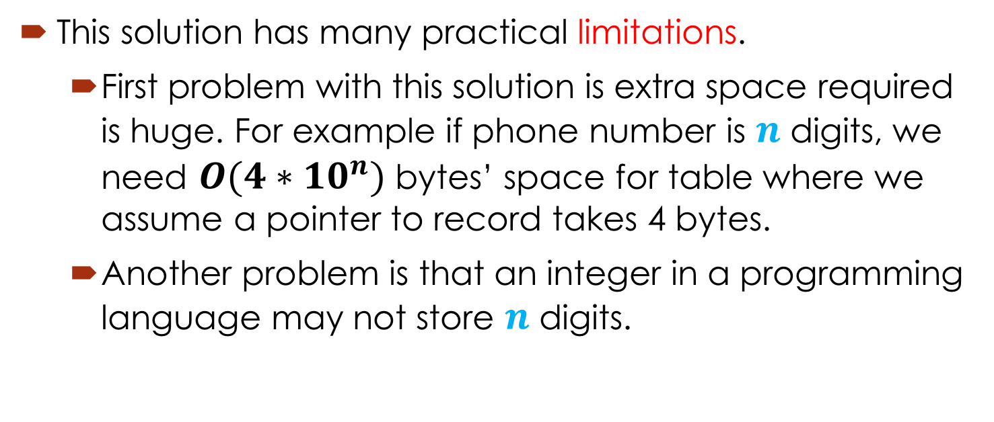
Introduction
This solution has many practical limitations.
First problem with this solution is extra space required is huge. For example if phone number is $n$ digits, we need $O(4∗{10}^{n})$bytes’ space for table where we assume a pointer to record takes 4 bytes.
Another problem is that an integer in a programming language may not store $n$ digits.

Slide 10
Introduction
Time complexity wise this solution is the best among all, we can do all operations in $O(1)$ time.
For example to insert a phone number, we create a record with details of given phone number, use phone number as index and store the pointer to the created record in table.

Slide 11
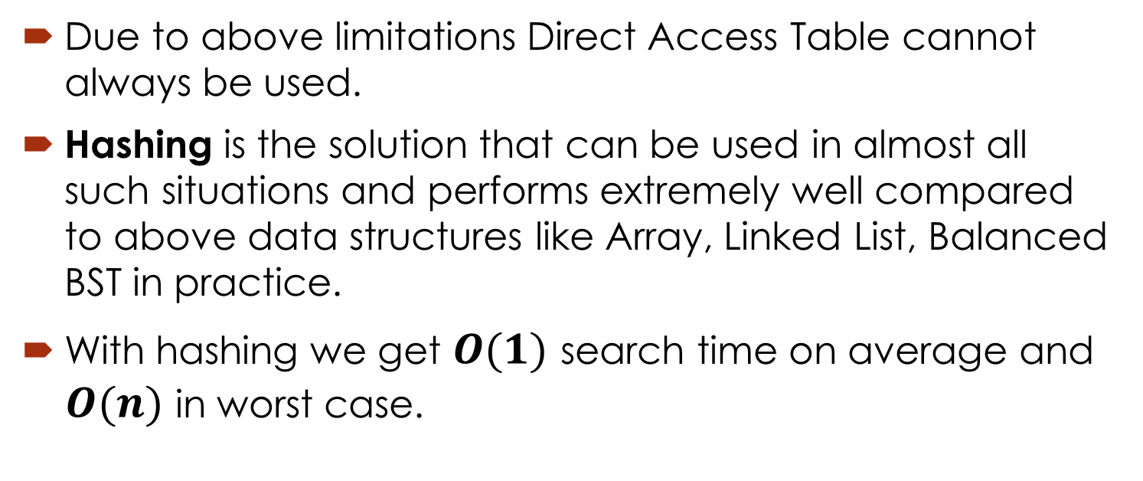
Introduction
Due to above limitations Direct Access Table cannot always be used.
Hashing is the solution that can be used in almost all such situations and performs extremely well compared to above data structures like Array, Linked List, Balanced BST in practice.
With hashing we get $O(1)$ search time on average and $O(n)$ in worst case.

Slide 12
Introduction
Hashing is an improvement over Direct Access Table.
The idea is to use hash function that converts a given phone number or any other key to a smaller number and uses the small number as index in a table called hash table.

Slide 13
What is a Hash Table ?
The simplest kind of hash table is an array of records.
This example has 701 records.
[ 0 ]
[ 1 ]
[ 2 ]
[ 3 ]
[ 4 ]
[ 5 ]
[ 700]
. . .
An array of records
Notes:
This lecture introduces hash tables, which are an array-based method for implementing a Dictionary. You should recall that we have seen dictionaries implemented in other ways, for example with a binary search tree. The abstract properties of a dictionary remain the same: We can insert items in the dictionary, and each item has a key associated with it. When we want to retrieve an item, we specify only the key, and the retrieval process finds the associated data.
What we do now is use an array to implement the dictionary. The array is an array of records. In this example, we could store up to 701 records in the array.

Slide 14
What is a Hash Table ?
[ 4 ]
Number 506643548
Each record has a special field, called its key.
In this example, the key is a long integer field called Number.
[ 0 ]
[ 1 ]
[ 2 ]
[ 3 ]
[ 4 ]
[ 5 ]
[ 700]
. . .
Notes:
Each record in the array contains two parts. The first part is a number that we'll use for the key of the item. We could use something else for the keys, such as a string. But for a hash table, numbers make the most convenient keys.

Slide 15
What is a Hash Table ?
[ 4 ]
Number 506643548
The number might be a person's identification number, and the rest of the record has information about the person.
[ 0 ]
[ 1 ]
[ 2 ]
[ 3 ]
[ 4 ]
[ 5 ]
[ 700]
. . .
Notes:
The numbers might be identification numbers of some sort, and the rest of the record contains information about a person. So the pattern that you see here is the same pattern that you've seen in other dictionaries: Each entry in the dictionary has a key (in this case an identifying number) and some associated data.

Slide 16
What is a Hash Table ?
When a hash table is in use, some spots contain valid records, and other spots are "empty".
[ 0 ]
[ 1 ]
[ 2 ]
[ 3 ]
[ 4 ]
[ 5 ]
[ 700]
Number 281942902
Number 233667136
Number 506643548
. . .
Number 155778322
Notes:
When a hash table is being used as a dictionary, some of the array locations are in use, and other spots are "empty", waiting for a new entry to come along.
Oftentimes, the empty spots are identified by a special key. For example, if all our identification numbers are positive, then we could use 0 as the Number that indicates an empty spot.
With this drawing, locations [0], [4], [6], and maybe some others would all have Number=0.

Slide 17
Inserting a New Record
Number 580625685
In order to insert a new record, the key must somehow be converted to an array index.
The index is called the hash value of the key.
[ 0 ]
[ 1 ]
[ 2 ]
[ 3 ]
[ 4 ]
[ 5 ]
[ 700]
Number 281942902
Number 233667136
Number 506643548
. . .
Number 155778322
Notes:
In order to insert a new entry, the key of the entry must somehow be converted to an index in the array. For our example, we must convert the key number into an index between 0 and 700. The conversion process is called hashing and the index is called the hash value of the key.

Slide 18
Inserting a New Record
Number 580625685
Typical way create a hash value:
(Number mod 701)
What is (580625685 mod 701) ?
[ 0 ]
[ 1 ]
[ 2 ]
[ 3 ]
[ 4 ]
[ 5 ]
[ 700]
Number 281942902
Number 233667136
Number 506643548
. . .
Number 155778322
Notes:
There are many ways to create hash values. Here is a typical approach.
a. Take the key mod 701 (which could be anywhere from 0 to 700).
So, quick, what is (580,625,685 mod 701) ?

Slide 19
Inserting a New Record
Number 580625685
Typical way to create a hash value:
(Number mod 701)
3
What is (580625685 mod 701) ?
[ 0 ]
[ 1 ]
[ 2 ]
[ 3 ]
[ 4 ]
[ 5 ]
[ 700]
Number 281942902
Number 233667136
Number 506643548
. . .
Number 155778322
Notes:
Three.

Slide 20
Inserting a New Record
Number 580625685
The hash value is used for the location of the new record.
[3]
[ 0 ]
[ 1 ]
[ 2 ]
[ 3 ]
[ 4 ]
[ 5 ]
[ 700]
Number 281942902
Number 233667136
Number 506643548
. . .
Number 155778322
Notes:
So, this new item will be placed at location [3] of the array.

Slide 21
Inserting a New Record
The hash value is used for the location of the new record.
[ 0 ]
[ 1 ]
[ 2 ]
[ 3 ]
[ 4 ]
[ 5 ]
[ 700]
Number 281942902
Number 233667136
Number 580625685
Number 506643548
. . .
Number 155778322
Notes:
The hash value is always used to find the location for the record.

Slide 22
Collisions
Number 701466868
Here is another new record to insert, with a hash value of 2.
My hash
value is [2].
[ 0 ]
[ 1 ]
[ 2 ]
[ 3 ]
[ 4 ]
[ 5 ]
[ 700]
Number 281942902
Number 233667136
Number 580625685
Number 506643548
. . .
Number 155778322
Notes:
Sometimes, two different records might end up with the same hash value.

Slide 23
Collisions
Number 701466868
This is called a collision, because there is already another valid record at [2].
When a collision occurs,
move forward until you
find an empty spot.
[ 0 ]
[ 1 ]
[ 2 ]
[ 3 ]
[ 4 ]
[ 5 ]
[ 700]
Number 281942902
Number 233667136
Number 580625685
Number 506643548
. . .
Number 155778322
Notes:
This is called a collision.
When a collision occurs, the insertion process will move forward through the array until an empty spot is found. Sometimes you will have a second collision...

Slide 24
Collisions
Number 701466868
This is called a collision, because there is already another valid record at [2].
When a collision occurs,
move forward until you
find an empty spot.
[ 0 ]
[ 1 ]
[ 2 ]
[ 3 ]
[ 4 ]
[ 5 ]
[ 700]
Number 281942902
Number 233667136
Number 580625685
Number 506643548
. . .
Number 155778322
Notes:
...and a third collision...

Slide 25
Collisions
Number 701466868
This is called a collision, because there is already another valid record at [2].
When a collision occurs,
move forward until you
find an empty spot.
[ 0 ]
[ 1 ]
[ 2 ]
[ 3 ]
[ 4 ]
[ 5 ]
[ 700]
Number 281942902
Number 233667136
Number 580625685
Number 506643548
. . .
Number 155778322
Notes:
But if there are any empty spots, eventually you will reach an empty spot, and the new item is inserted here.

Slide 26
Collisions
This is called a collision, because there is already another valid record at [2].
The new record goes
in the empty spot.
[ 0 ]
[ 1 ]
[ 2 ]
[ 3 ]
[ 4 ]
[ 5 ]
[ 700]
Number 281942902
Number 233667136
Number 580625685
Number 506643548
Number 701466868
. . .
Number 155778322
Notes:
The new record is always placed in the first available empty spot, after the hash value.

Slide 27
A Quiz
Where would you be placed in this table, if there is no collision? Use your social security number or some other favourite number.
[ 0 ]
[ 1 ]
[ 2 ]
[ 3 ]
[ 4 ]
[ 5 ]
[ 700]
Number 281942902
Number 233667136
Number 580625685
Number 506643548
Number 701466868
. . .
Number 155778322
Notes:
Time for another quiz . . . Did anyone end up with a hash value of 700?
Well, I did. My ID number is 155779023, which has a hash value of 700. (No, not really, but I needed to illustrate another kind of collision.
There is a collision with the last location of the array. In this case, you would circle back to the start of the array, and try location number 0, then 1, .... until you find an empty spot. In this example, I would be inserted at location 0, since that location is empty.

Slide 28
Searching for a Key
Number 701466868
The data that's attached to a key can be found fairly quickly.
[ 0 ]
[ 1 ]
[ 2 ]
[ 3 ]
[ 4 ]
[ 5 ]
[ 700]
Number 281942902
Number 233667136
Number 580625685
Number 506643548
Number 701466868
. . .
Number 155778322
Notes:
It is fairly easy to search for a particular item based on its key.

Slide 29
Searching for a Key
Number 701466868
Calculate the hash value.
Check that location of the array for the key.
My hash
value is [2].
Not me.
[ 0 ]
[ 1 ]
[ 2 ]
[ 3 ]
[ 4 ]
[ 5 ]
[ 700]
Number 281942902
Number 233667136
Number 580625685
Number 506643548
Number 701466868
. . .
Number 155778322
Notes:
Start by computing the hash value, which is 2 in this case. Then check location 2. If location 2 has a different key than the one you are looking for, then move forward...

Slide 30
Searching for a Key
Number 701466868
Keep moving forward until you find the key, or you reach an empty spot.
My hash
value is [2].
Not me.
[ 0 ]
[ 1 ]
[ 2 ]
[ 3 ]
[ 4 ]
[ 5 ]
[ 700]
Number 281942902
Number 233667136
Number 580625685
Number 506643548
Number 701466868
. . .
Number 155778322
Notes:
...if the next location is not the one we are looking for, then keep moving forward...

Slide 31
Searching for a Key
Number 701466868
Keep moving forward until you find the key, or you reach an empty spot.
My hash
value is [2].
Not me.
[ 0 ]
[ 1 ]
[ 2 ]
[ 3 ]
[ 4 ]
[ 5 ]
[ 700]
Number 281942902
Number 233667136
Number 580625685
Number 506643548
Number 701466868
. . .
Number 155778322
Notes:
Keep moving forward until you find the sought-after key...

Slide 32
Searching for a Key
Number 701466868
Keep moving forward until you find the key, or you reach an empty spot.
My hash
value is [2].
Yes!
[ 0 ]
[ 1 ]
[ 2 ]
[ 3 ]
[ 4 ]
[ 5 ]
[ 700]
Number 281942902
Number 233667136
Number 580625685
Number 506643548
Number 701466868
. . .
Number 155778322
Notes:
In this case we find the key at location [5].

Slide 33
Searching for a Key
Number 701466868
When the item is found, the information can be copied to the necessary location.
My hash
value is [2].
Yes!
[ 0 ]
[ 1 ]
[ 2 ]
[ 3 ]
[ 4 ]
[ 5 ]
[ 700]
Number 281942902
Number 233667136
Number 580625685
Number 506643548
Number 701466868
. . .
Number 155778322
Notes:
The data from location [5] can then be copied to to provide the result of the search function.
What happens if a search reaches an empty spot? In that case, it can
halt and indicate that the key was not in the hash table.

Slide 34
Deleting a Record
Records may also be deleted from a hash table.
Please
delete me.
[ 0 ]
[ 1 ]
[ 2 ]
[ 3 ]
[ 4 ]
[ 5 ]
[ 700]
Number 281942902
Number 233667136
Number 580625685
Number 506643548
Number 701466868
. . .
Number 155778322
Notes:
Records can be deleted from a hash table...

Slide 35
Deleting a Record
Records may also be deleted from a hash table.
[ 0 ]
[ 1 ]
[ 2 ]
[ 3 ]
[ 4 ]
[ 5 ]
[ 700]
Number 281942902
Number 233667136
Number 580625685
Number 701466868
. . .
Number 155778322
Notes:
But the spot of the deleted record cannot be left as an ordinary empty spot, since that would interfere with searches. (Remember that a search can stop when it reaches an empty spot.)

Slide 36
Deleting a Record
Records may also be deleted from a hash table.
But the location must not be left as an ordinary "empty spot" since that could interfere with searches.
[ 0 ]
[ 1 ]
[ 2 ]
[ 3 ]
[ 4 ]
[ 5 ]
[ 700]
Number 281942902
Number 233667136
Number 580625685
Number 701466868
. . .
Number 155778322
Notes:
But the spot of the deleted record cannot be left as an ordinary empty spot, since that would interfere with searches. (Remember that a search can stop when it reaches an empty spot.)

Slide 37
Deleting a Record
Records may also be deleted from a hash table.
But the location must not be left as an ordinary "empty spot" since that could interfere with searches.
The location must be marked in some special way so that a search can tell that the spot used to have something in it.
[ 0 ]
[ 1 ]
[ 2 ]
[ 3 ]
[ 4 ]
[ 5 ]
[ 700]
Number 281942902
Number 233667136
Number 580625685
Number 701466868
. . .
Number 155778322
Notes:
Instead we must somehow mark the location as "a location that used to have something here, but no longer does."
We might do this by using some other special value for the Number field of the record.
In any case, a search can not stop when it reaches "a location that used to have something here". A search can only stop when it reaches a true empty spot.

Slide 38
Hash Function
Hash Function: A function that converts a given big phone number (key) to a small practical integer value (index).
The mapped integer value is used as an index in hash table.
In simple terms, a hash function maps a big number or string to a small integer that can be used as index in hash table.

Slide 39
Hash Function
For example for phone numbers a bad hash function is to take first three digits. Why?
(760)-750-8241
(760)-750-4567
...
A better function is consider last three digits.
Please note that this may not be the best hash function. There may be better ways.

Slide 40
Hash Function
A hash function that maps names to integers from 0 to 15. There is a collision between keys "John Smith" and "Sandra Dee".

Slide 41
Hash Function
Hash functions are related to (and often confused with) checksums, check digits, fingerprints, lossy compression, randomization functions, error-correcting codes, and ciphers.
Although these concepts overlap to some extent, each has its own uses and requirements and is designed and optimized differently.
For example, the Hash Keeper database maintained by the American National Drug Intelligence Center is more aptly described as a catalogue of file fingerprints than of hash values.

Slide 42
Hash Function
Good hash functions, in the original sense of the term, are usually required to satisfy certain properties listed below.
1. Determinism
2. Uniformity
3. Defined range
4. Data normalization
5. Continuity
6. Non-invertible

Slide 43
Hash Function
1. Determinism
A hash procedure must be deterministic—meaning that for a given input value it must always generate the same hash value.
2. Uniformity
A good hash function should map the expected inputs as evenly as possible over its output range. That is, every hash value in the output range should be generated with roughly the same probability.

Slide 44
Hash Function
3. Defined range
It is often desirable that the output of a hash function have fixed size.
4. Data normalization
In some applications, the input data may contain features that are irrelevant for comparison purposes. For example, when looking up a personal name, it may be desirable to ignore the distinction between upper and lower case letters.

Slide 45
Hash Function
5. Continuity
A hash function that is used to search for similar (as opposed to equivalent) data must be as continuous as possible; two inputs that differ by a little should be mapped to equal or nearly equal hash values.
6. Non-invertible
In cryptographic applications, hash functions are typically expected to be practically non-invertible.

Slide 46
Hash Function Algorithms
Perfect hashing
A hash function that is injective—that is, maps each valid input to a different hash value—is said to be perfect.
A perfect hash function for the four names shown

Slide 47
Hash Function Algorithms
Minimal perfect hashing
A perfect hash function for n keys is said to be minimal if its range consists of n consecutive integers
A minimal perfect hash function for the four names shown

Slide 48
Hash Function Algorithms
Trivial hash function
If the data (key) to be hashed is small enough, one can use the data itself (reinterpreted as an integer) as the hashed value (index).
For example, in Java, the hash code is a 32-bit integer, which can simply be used as the hash value.
String key = “123456”;
int hash = key.hashCode();
int index = hash % table_size;

Slide 49
Popular Hash Algorithms:
1. Cryptographic hash functions
SHA-1, SHA-2 RSA, SHA-2 DSA, SHA-3, MD5, etc.
2. Non-cryptographic hash functions
DJBX33A (5381), MurmurHash, CityHash, FNV, SuperFastHash, etc.
3. Cyclic redundancy checks
CRC32, etc.

Slide 50
Hash Algorithms Comparisons:

Slide 51
Hash Algorithms Comparisons:

Slide 52
Bad Function Algorithms

Slide 53
Bad Hash Algorithms:
Examples of bad hash functions:
int hash(string input) { return input.length; }
int hash(float input) { return 0; }
int hash(int input) { return 1; }

Slide 54
Good Hash Algorithms:
An example of a good hash function for small integers:
int hash(int input) { return input; }

Slide 55
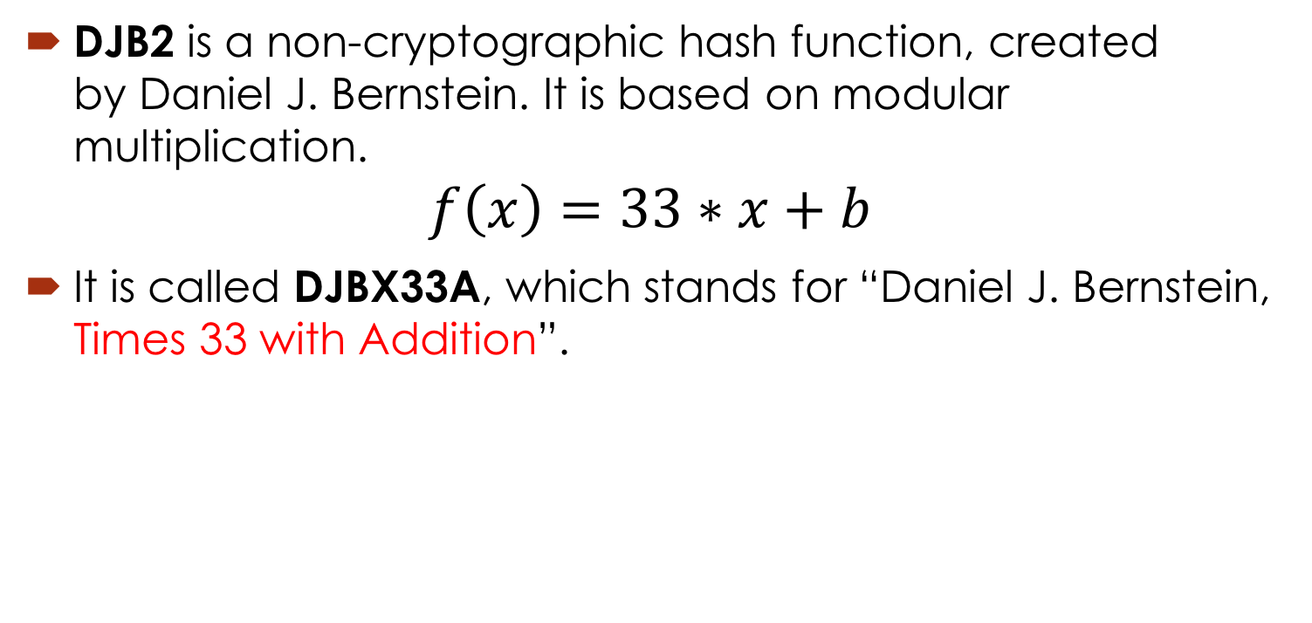
Popular Hash Algorithms: DJB2
DJB2 is a non-cryptographic hash function, created by Daniel J. Bernstein. It is based on modular multiplication.
$$f\left(x\right)=33∗x+b$$
It is called DJBX33A, which stands for “Daniel J. Bernstein, Times 33 with Addition”.

Slide 56
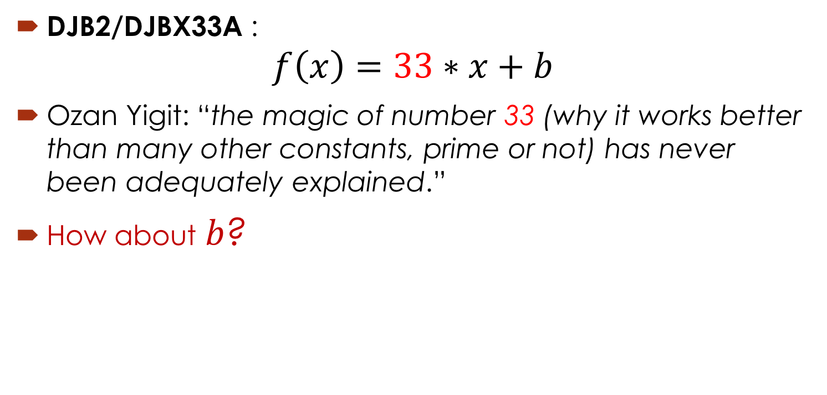
Popular Hash Algorithms: DJB2
DJB2/DJBX33A :
$$f\left(x\right)=33∗x+b$$
Ozan Yigit: “the magic of number 33 (why it works better than many other constants, prime or not) has never been adequately explained.”
How about $b$?

Slide 57
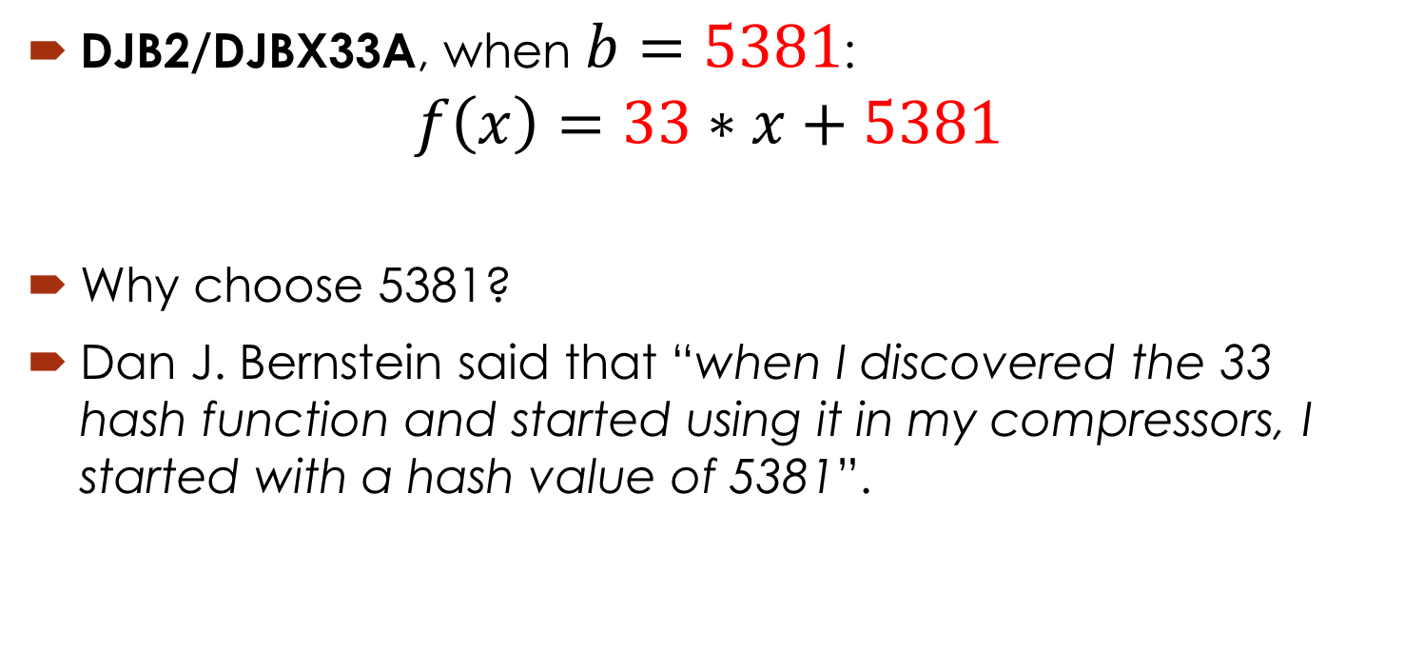
Popular Hash Algorithms: DJB2
DJB2/DJBX33A, when $b=5381$:
$$f\left(x\right)=33∗x+5381$$
Why choose 5381?
Dan J. Bernstein said that “when I discovered the 33 hash function and started using it in my compressors, I started with a hash value of 5381”.

Slide 58
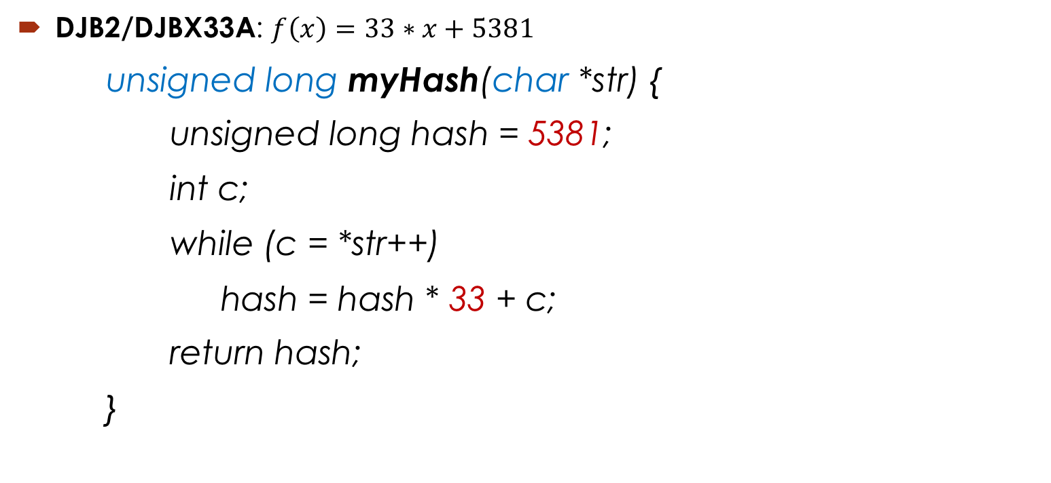
Popular Hash Algorithms: DJB2
DJB2/DJBX33A: $f\left(x\right)=33∗x+5381$
unsigned long myHash(char *str) {
unsigned long hash = 5381;
int c;
while (c = *str++)
hash = hash * 33 + c;
return hash;
}

Slide 59
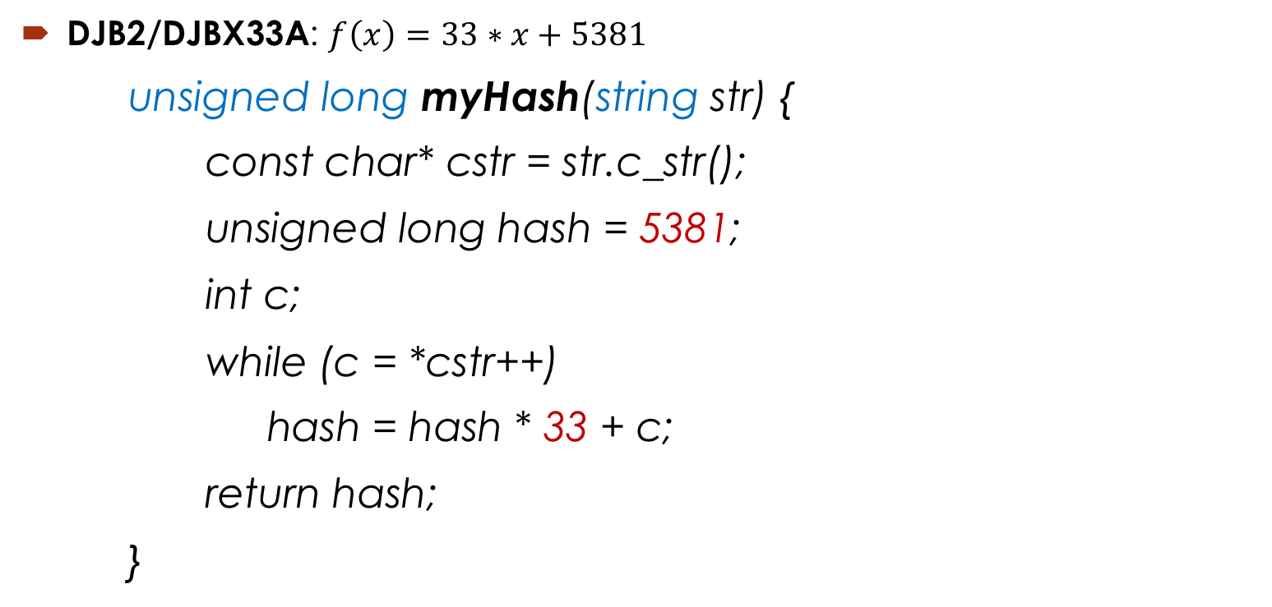
Popular Hash Algorithms: DJB2
DJB2/DJBX33A: $f\left(x\right)=33∗x+5381$
unsigned long myHash(string str) {
const char* cstr = str.c_str();
unsigned long hash = 5381;
int c;
while (c = *cstr++)
hash = hash * 33 + c;
return hash;
}

Slide 60
Hash Table Implementation
Now let’s implement a simple hash table by using the DJB2 hash function.
Before doing so, we have to answer one important question:
what should we do for collisions?

Slide 61
Collision Handling
Since a hash function gets us a small number for a big key, there is possibility that two keys result in same value.
The situation where a newly inserted key maps to an already occupied slot in hash table is called collision and must be handled using some collision handling technique.

Slide 62
Collision Handling
Open Hashing:
In open hashing, keys are stored in linked lists attached to cells of a hash table.
For example: the Separate Chaining technique
Closed Hashing:
In closed hashing, all keys are stored in the hash table itself without the use of linked lists.
For example: the Open Addressing technique

Slide 63
Collision Handling
Separate Chaining (Open Hashing):
The idea is to make each cell of hash table point to a linked list of records that have same hash function value.
Chaining is simple, but requires additional memory outside the table.
Open Addressing (Closed Hashing):
In open addressing, all elements are stored in the hash table itself. Each table entry contains either a record or NIL.
When searching for an element, we one by one examine table slots until the desired element is found or it is clear that the element is not in the table.

Slide 64
Collision Handling
Separate Chaining (Open Hashing):
Let us consider a simple hash function as “key mod 7” and sequence of keys as 50, 700, 76, 85, 92, 73, 101.

Slide 65
Collision Handling
Separate Chaining (Open Hashing):
Advantages/Pros:
1) Simple to implement.
2) Hash table never fills up, we can always add more elements to chain.
3) Less sensitive to the hash function or load factors.
4) It is mostly used when it is unknown how many and how frequently keys may be inserted or deleted.

Slide 66
Collision Handling
Separate Chaining (Open Hashing):
Disadvantages/Cons:
1) Cache performance of chaining is not good as keys are stored using linked list.
2) Wastage of Space (Some Parts of hash table are never used)
3) If the chain becomes long, then search time can become O(n) in worst case.
4) Uses extra space for links.

Slide 67
Collision Handling
Open Addressing (Closed Hashing):
Like separate chaining, open addressing is a method for handling collisions.
In Open Addressing, all elements are stored in the hash table itself.
So at any point, size of table must be greater than or equal to total number of keys.

Slide 68
Collision Handling
Open Addressing (Closed Hashing):
Insert(k): Keep probing until an empty slot is found. Once an empty slot is found, insert k.
Search(k): Keep probing until slot’s key doesn’t become equal to k or an empty slot is reached.
Delete(k): Delete operation is interesting. If we simply delete a key, then search may fail. So slots of deleted keys are marked specially as “deleted”.
Insert can insert an item in a deleted slot, but search doesn’t stop at a deleted slot.

Slide 69
Collision Handling
Open Addressing is done following ways:
a) Linear Probing: In linear probing, we linearly probe for next slot. For example, typical gap between two probes is 1 as taken in below example also.

Slide 70
Collision Handling
a) Linear Probing: Let us consider a simple hash function as “key mod 7” and sequence of keys as 50, 700, 76, 85, 92, 73, 101. in below example also.

Slide 71
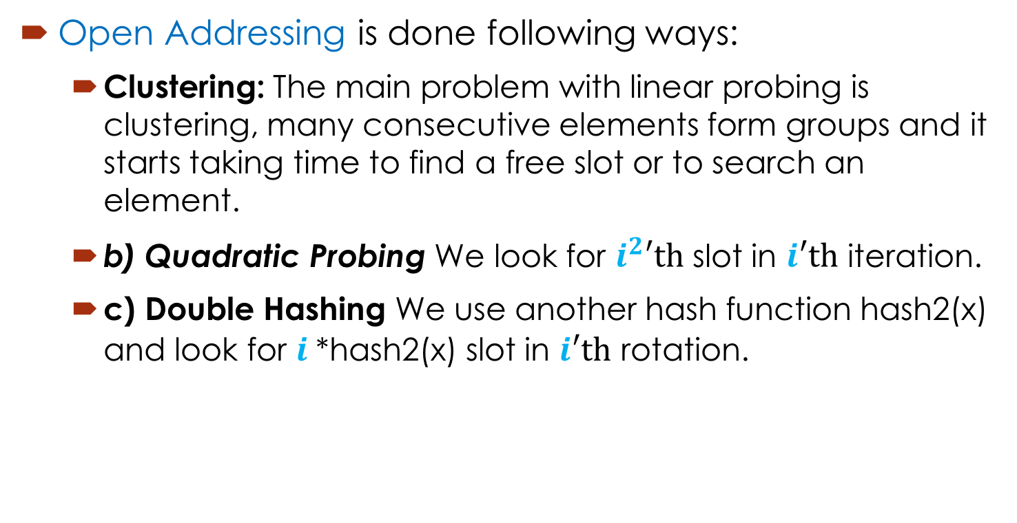
Collision Handling
Open Addressing is done following ways:
Clustering: The main problem with linear probing is clustering, many consecutive elements form groups and it starts taking time to find a free slot or to search an element.
b) Quadratic Probing We look for $i^{2}′th$ slot in $i′th$ iteration.
c) Double Hashing We use another hash function hash2(x) and look for $i$*hash2(x) slot in $i′th$ rotation.

Slide 72
Collision Handling
Open Addressing (Closed Hashing):
Comparison of above three:
Linear probing has the best cache performance, but suffers from clustering. One more advantage of Linear probing is easy to compute.
Quadratic probing lies between the two in terms of cache performance and clustering.
Double hashing has poor cache performance but no clustering. Double hashing requires more computation time as two hash functions need to be computed.

Slide 73
Collision Handling
Open Addressing (Closed Hashing):
Advantages/Pros of Open Addressing:
1) Open addressing provides better cache performance as everything is stored in same table.
2) In Open addressing, a slot can be used even if an input doesn’t map to it.

Slide 74
Hash Table Implementation
class Entry {
string key;
int value;
public:
Entry(string key, int value) {
this->key = key;
this->value = value;
}
string getKey() { return key; }
int getValue() { return value; }
};

Slide 75
Hash Table Implementation
class HashMap {
Entry **table;
int size;
public:
HashMap(int size) {
this->size = size;
table = new Entry*[size];
for (int i = 0; i < size; i++)
table[i] = NULL;
}

Slide 76
Hash Table Implementation
void put(Entry *e) {
string key = e->getKey();
int index = myHash(key) % size;
int startIndex = index;
while (table[index] != NULL && table[index]->getKey() != key && table[index]->getKey() != “empty”) {
index = (index + 1) % size;
if(index == startIndex) throw Overflow();
}
table[index] = e;
}

Slide 77
Hash Table Implementation
Entry* get(string key) {
int index = myHash(key) % size;
int startIndex = index;
while (table[index] != NULL && table[index]->getKey() != key) {
index = (index + 1) % size;
if(index == startIndex) return NULL;
}
return table[index];
}

Slide 78
Hash Table Implementation
Entry* remove(string key) {
int index = myHash(key) % size;
int startIndex = index;
while (table[index] != NULL && table[index]->getKey() != key) {
index = (index + 1) % size;
if(index == startIndex) return NULL;
}
Entry *e = table[index];
delete e;
table[index] = new Entry(“empty”, 0);
return e;
}

Slide 79
Hash Table Implementation
~HashMap() {
for (int i = 0; i < size; i++)
if (table[i] != NULL)
delete table[i];
delete[] table;
}

